Slide 1
IEEE Sections Congress 2014
Region Coordinators Update:
JANUARY 2014

Slide 2
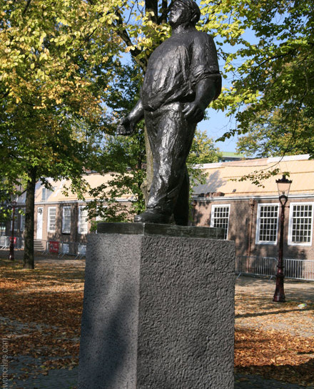
Overview
SC14 Recommendations Process/Timeline – slide 3-4 (**updated information)
SC14 Logistics – slides 5-9 (**updated information)
SC14 Tentative Program Schedule – slide 10
SC14 Track Titles, Track Chairs – slide 11
SC14 Key Milestones – slide 12
Supporting information – slides 13-17
SC14 Committee; SC14 Region Coordinators – slides 13-14
Sections Congress is… – slide 15
SC Goals and Objectives – slide 16
Theme and Program Creative Design – slide 17
SC11 Recommendations Update – slides 18-23
SC14 Staff Contact Information – slide 24

Slide 3
SC14 Recommendations Process
13 December 2013 - Call to Regions
16 May 2014 – Each region finalizes and submits its prioritized recommendations
Objective of four recommendations
Encourage consideration of long term vision of IEEE and alignment with MGA five year strategies.
Recommendations in the MGA span of control will have greater probability of implementation. Those that are outside of the MGA domain will be evaluated by the impacted Organizational Unit.
MGA Operations Committee and SC14 Program Committee takes ownership of the recommendations to review and modify if necessary. Remove duplicates, ensure clarity.
7 July 2014 - All remaining recommendations distributed with back up information to SC14 attendees to begin assessment.
Delegate voting can be completed anytime during the Congress up to Sunday noon using mobile app and web.
Social media strategy to allow for discussion of recommendation items prior to, during and after Congress
24 August 2014 - Top 5 recommendations presented at Closing Ceremony

Slide 4
Recommendations Process Timeline
Date | Action | Notes
13 Dec 2013 | Recommendations form and instructions distributed to Region Directors, Director-Elects, SC2014 Coordinators
16 May 2014 | Each Region returns 4 draft recommendations to Program Committee
17 May 2014- 5 July 2014 | Program Committee vets recommendations
7 July 2014 | List of Region recommendations distributed to Region Directors, Director-Elects, SC2014 Coordinators, SC registrants; added to mobile app, SC website, social media | Continuous discussion via social media, website, mobile app
22-24 Aug 2014 | Voting is open; closes at 12:00 PM on Sunday, 24 August
24 Aug 2014 | Top five recommendations announced at Closing Ceremony

Slide 5
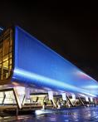
Logistics (** updated information)
What | When/Where
Dates of Congress | 22-24 August 2014
Registration Rate | $550, **exclusive of 21% VAT to be calculated at completion of registration *Registration fee and 3 nights hotel stay for PSDs are covered by MGA
City | Amsterdam, Netherlands
Venue | Amsterdam RAI-Exhibition and Convention Centre
Partner/Children fee | $160, **exclusive of 21% VAT to be calculated at completion of registration Fee will cover dinners on Friday (Opening Ceremony) and Saturday (Honors Ceremony) Children 6 years old and younger are free

Slide 6
Logistics (** updated information)
What | When/Where
Air travel/discount codes | United - Offer Code: ZQUE277033 5%-10% off published fares Reserve through www.united.com or by calling United Meetings at 800-426-1122 **United – Offer Code (USA ONLY): ZR9A316403 Travel window: 8/17/2014 - 8/30/2014 KLM/Delta Airlines - -Meeting Code: NMGV6 5%-10% off published fares Reserve through www.delta.com or by calling Delta Meeting at 800-328-1111
Other Meetings/Events: Region meetings Honors Ceremony - IEEE BoD | -Confirmed Region meetings: R3, R4; Tentative R6, R8, R10 -6:00 PM, Saturday, 23 August @ RAI -Monday, Tuesday, 25 & 26 August
**For Region meeting expense estimates (meeting rooms/food & beverage/AV), contact IEEE MCE Team at sc14reg@ieee.org **Requests to reserve space for Region Meetings will be managed through SC Registration site

Slide 7
Logistics (** updated information)
What/When | Where
City Sightseeing Tour of Amsterdam Departs from RAI Saturday 23 August 2014, 9:00 - 15:00 hrs | € 85 per person (including VAT) $ 117 per person (including VAT) A tour which will include a most extensive drive through the center and the modern suburbs and will give you a good idea of the most interesting sights and monuments Amsterdam has to offer. A stop will be made at a diamond factory (if requested) and we will visit the National museum of Amsterdam, “the Rijksmuseum”. This museum is world famous and here the largest collection of paintings by the Dutch old masters can be admired. Work from Frans Hals, Jan Steen and Rembrandt (the nightwatch painting) are assembled here. As an alternative we can visit the famous Van Gogh Museum. Including: - Private coach 6 hours - English speaking guide 09.00 – 15.00hrs - Lunch in restaurant Haesje Claes, including 2 soft drinks and coffee/tea - Entrance fee Rijksmuseum
Royal Amsterdam Tour Departs from RAI Sunday 24 August 2014, 9:00 - 14:00 hrs | € 85.50 per person (including VAT) $ 118 per person (including VAT) The first stop is a visit to The Royal Palace Amsterdam. After the visit of the Royal Palace, we will have a look inside the Nieuwe Kerk, a characteristic church and very special for our royal family. See Amsterdam from the water during a canal cruise of 2 hours in a private boat. A three course lunch, including 2 soft drinks and coffee/tea is served during this cruise. Lunch Mediterraneo consists of as many as three courses, prepared by the head chef of our caterer Buon Vino. He is inspired by the regional Italian cuisine and only uses fresh ingredients and traditional products. Including: - One way transfer with private coach from Amsterdam RAI to city centre - English speaking guide 09.00 – 14.00hrs - Entrance fee Royal Palace - Specialized guides at the Royal Palace The cruise will start in the city centre, and end at Amsterdam RAI.

Slide 8
Logistics (** updated information)
What | When/Where
Hotels and Hotel Rates | Average rate: €140/$187 Room blocks being held at multiple hotels, most are within a 10 minute walk to the RAI.
**Hotel Room Reservations – process for SC2014 | A link will reside in the SC14 Registration site to make hotel reservations All attendees required to use their credit cards to guarantee their individual reservations. This allows for attendees to extend their stay, if desired, and to cancel or add days as needed within 48 hours of the first night’s stay without penalty. Their credit card is charged at the end of their stay. Reimbursement for hotel and other travel costs will be managed via an expense report to their Section or Region treasurer (depending on how each Region chooses to handle this). Reimbursement to Regions for PSD hotel rooms will be done via Concentration Banking or Custody Account transfers from MGA Local law requires that any cancellations to an individual booking on a group rate will result in substantial penalties beginning 90 days out from the event. Attendees would be required to pay full price for days they may cancel 60 days out from the event. The additional staff hours to manage the fees associated with these bookings would also be significant without the new process.

Slide 9
Hotel Logistics **All sleeping room rates EXCLUDE 5,5% city tax, 6% VAT and Breakfast **All sleeping room rates INCLUDE Internet access
Hotel | Location (see legend below) | Rates for IEEE SC 2014
Okura Amsterdam | 1 | € 195
Crown Plaza South - standard room | 2 | € 129
Crown Plaza South - superior room | 2 | € 174
Holiday Inn Amsterdam - standard room | 1 | € 129
Holiday Inn Amsterdam - deluxe room | 1 | € 159
Holiday Inn Amsterdam - executive room | 1 | € 179
NH Musica | 2 | € 129
Novotel Amsterdam - superior rooms | 1 | € 129
Novotel Amsterdam - executive rooms | 1 | € 154
Wyndham Apollo - deluxe room | 1 | € 129
Wyndham Apollo - executive room | 1 | € 164
CitizenM | 1 | € 119
Location Legend: 1= within walking distance of RAI (max. 15 minutes); 2=within 5-10 minutes travel by taxi
**All rates EXCLUDE 5,5% city tax, 6% VAT and Breakfast ** Room rates INCLUDE Internet access

Slide 10
Tentative Program Schedule **Subject to Change
Friday, 22 August
TA Sponsored Cocktail Reception 4:00 PM
Opening Ceremony / Dinner 5:00 PM
Entertainment 8:00 PM
Saturday, 23 August
Breakfast | 6:30 AM
General Session Doors Open | 8:00 AM
General Session IEEE President Keynote Speaker VP MGA Ignite SC2014 | 8:30 AM - 11:50 AM
Coffee Break | 9:45 AM
Lunch / Exhibits Open | 11:50 AM
Breakout Session 1 | 1:30 PM
Coffee Break & Open Exhibits | 2:45 PM
Breakout Session 2 | 3:45 PM
Saturday Program Ends | 5:00 PM
Honor Ceremony Starts | 6:00 PM
Sunday, 24 August
Exhibit Hall Open | 6:30 AM to 5:00 PM
Breakfast | 6:30 AM
Breakout Session 3 | 8:00 AM
Coffee Break & Open Exhibits | 9:15 AM
Breakout Session 4 | 10:15 AM
Lunch and Exhibits !! VOTING ENDS !! | 11:30 AM !! 12:00 PM !!
Breakout Session 5 | 1:30 PM
Coffee Break & Open Exhibits | 2:45 PM
Closing Ceremony Announce voting results Keynote Speaker IEEE President-Elect Invitation to SC2017 Closing Remarks | 3:15 PM
SC2014 closes | 5:00 PM

Slide 11
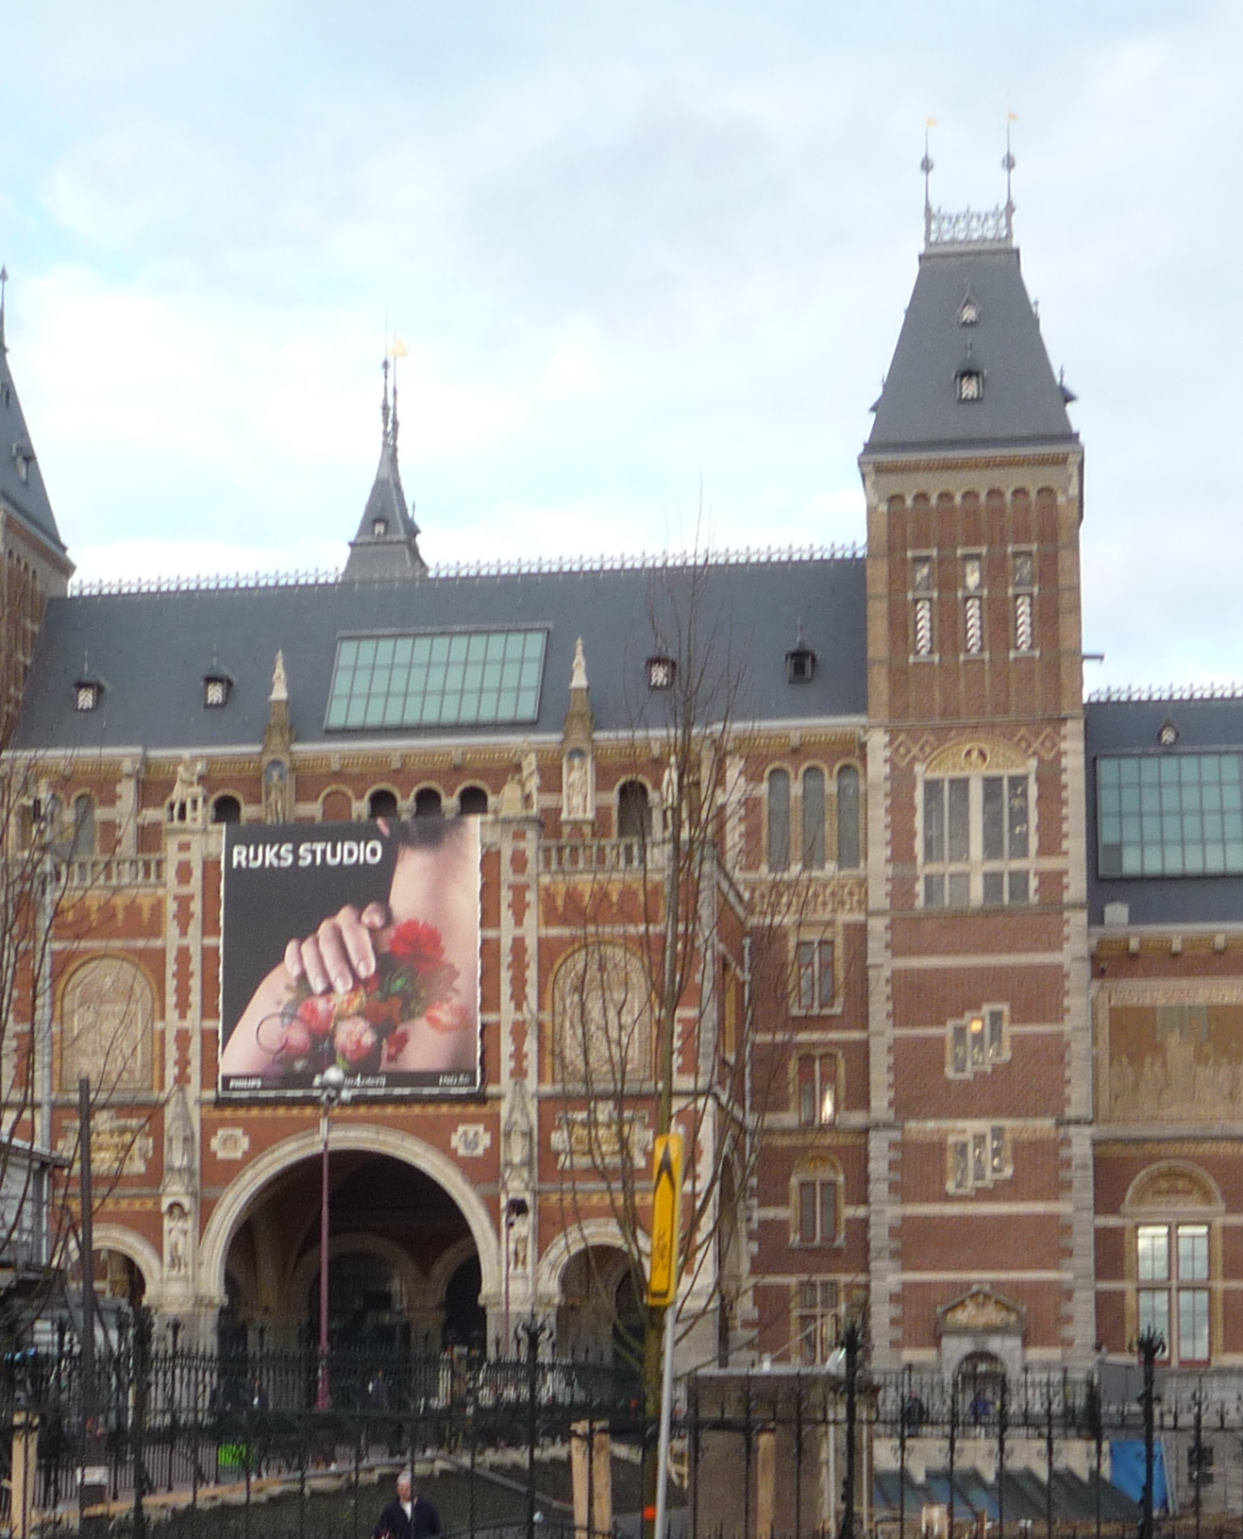
Sections Congress 2014 – Tentative Program Track Titles, Sessions Subject to Change
Program track titles/chairs:
Be Globally Authentic and Locally Valuable
Track Chair: Elya Joffe, R8
Enhancing Member Satisfaction
Track Chair: Tania Quiel, R9
Improving the Volunteer Experience
Track Chair: Sanjib Panda, R10
In addition to the general and breakout sessions, the following will be incorporated into the Congress:
Ignite sessions
Learning labs
Meet ups
Birds of a Feather

Slide 12
SC14 Select Key Milestones
1st Half 2013
Finalize theme and creative design - completed
Finalize Program tracks and workshop choices- completed
Final budget / registration rates available- completed
2nd Half 2013
Finalize plans for OU participation in SC14 - completed
Recommendation process plans completed- completed
Speakers identified- completed
1st Half 2014
Registration live in February
Mobile app launched
Local activity plans completed - completed
2nd Half 2014
SC14 held in August
Registration rates communicated

Slide 13
MGA Sections Congress 2014 Committee Members
Magdalena Salazar Palma (R8), Chair
Tom Coughlin (R6), Past Chair
Murty Polavarapu (R2), Program Committee Chair
Wilhelm Van Etten (R8), Local Organizing Committee Chair
Cor Claeys (R8), Fundraising Committee Chair
Martin Bastiaans (R8), 2013-2014 Region 8 Director
Ralph Ford (R2), 2013 VP-MGA

Slide 14
SC14 Regional Coordinators
R1 – Charles Rubenstein | R6 – Loretta Arellano
R2 – Joseph Kalasky | R7 – Anader Benyamin-Seeyar
R3 – Chris Hardy | R8 – Athanassios Skodras
R4 – Bruce Howell | R9 – Gustavo Giannattasio
R5 – John Reinert | R10 – Zia Ahmed

Slide 15
IEEE Sections Congress is…
The opportunity for IEEE volunteers from around the world to participate in a truly unique event. The congress provides the attendees to increase their leadership skills and to gain a working knowledge of IEEE.
It is also a venue to express concerns and opinions through the recommendations process. The recommendations, that the Section Delegates vote on, are then used by the IEEE Board of Directors to guide IEEE into the future.

Slide 16
Sections Congress 2014 Goals and Objectives
Increase member engagement and Section vitality
Provide training to
Develop leadership skills
Enable and nurture volunteering efforts
Share best practices
Learn about available programs
Provide for networking opportunities at grass-roots level

Slide 17
SC14 – Theme and Creative Design
Inspiring Our Leaders of Tomorrow

Slide 18
Sections Congress 2011 Recommendations Update
The Primary Section Delegates voted on the IEEE Sections Congress 2011 Recommendations during the Closing Ceremony on Monday, 22 August.
The following slides include the top 5 recommendations and the current status as of June 2013.
The next update to the 2011 recommendations will be provided in February 2014.

Slide 19
Sections Congress 2011 Recommendations Update 1. Pre-University Long Term Strategy Assigned to IEEE Educational Activities Board
IEEE to develop a long-term strategy to increase the number of next generation youth pursuing science and engineering careers.
Business plan for initiatives in development
Long-term strategy is expected to be developed by year end 2013. Will be reported to IEEE Board of Directors, Educational Activities Board, and Member and Geographic Activities Board

Slide 20
Sections Congress 2011 Recommendations Update 2. Global Fidelity Program Assigned to MGA Member Engagement and Life Cycle Committee (MELCC)
As members maintain their IEEE membership over the years, IEEE must reward them for their loyalty. Rewards ought to be tangible and useful and can be done simply and inexpensively. Create Global Fidelity Programs including: (a) Continue membership Recognition 5-10-15-20 years of membership; (b) Bonus for specific Benefits (e.g., reduced fee, IEEE merchandise, etc).
Motion passed at February 2013 MGA Board meeting to test a pilot of a loyalty program for 2015 Membership Year to renewing members in years 2, 5, 10, and 20.
Final decision to be made at the June or November MGAB meeting after full understanding of budget considerations
MGA MELCC will provide MGA Board, at its Nov 2013 meeting:
Refined financial projections in order to give final go ahead for the pilot for 2015 Membership Year (August 2014)
Costs of reward fulfillment
Costs of implementation

Slide 21
Sections Congress 2011 Recommendations Update 3. Bundled Society Membership Assigned to MGA and TAB
IEEE membership (including e-Membership) should include a Society membership as part of the basic membership fee.
At the end of 2011 due to financial risks being unknown, a direct plan to include a bundled society with IEEE membership for the 2013 membership year was not moved forward
A joint MGA/TA ad hoc was formed to determine how to move this effort forward.
The committee decided to run a test of bundled membership for a random sample of members for the 2013 and 2014 membership years. The test is underway.
The expected completion of the test is Q1 of 2014. (Note: In order to test both the take rates of a bundled society, as well as the retention rates of those members who take the society, the test will extend over the 2013 and 2014 membership years.)
If the test proves that bundled membership will increase retention, and the financial risk is acceptable, the likely timeframe for a go-forward decision would be June or November 2014.

Slide 22
Sections Congress 2011 Recommendations Update 4. Student Grants Assigned to MGA Finance
Increased support to students in technical activities with grants to attend conferences and organization of technical competitions.
A discovery process uncovered a wide array of existing grants for this throughout IEEE.
However, finding these programs was extremely difficult as they were in many different locations throughout IEEE. This is not a good experience for our members.
A centralized location (likely a website) will be developed that will allow students to quickly link to all of the existing opportunities for grants to attend conferences and organize competitions.
An inventory, links and the Students portal page are being created and designed for November ‘13.

Slide 23
Sections Congress 2011 Recommendations Update 5. Pre-University Periodical Assigned to Educational Activities Board (EAB)
To encourage interest in pre-university students in engineering careers, IEEE to publish a subscription periodical (paper or electronic) targeted to high school students that highlights engineering activities of interest to those students. The periodical should also have articles promoting the benefits of an engineering career and what the students can do in college to get involved with IEEE.
In response to this, the EA created IEEE Spark (http://spark.ieee.org/), a monthly online publication referred to in Recommendation #4.
EA provided the operational support of this publication for the three issues that were published in 2012-January, April and July
EA submitted subsequent proposals to the IEEE New Initiatives Committee to request additional funding to be included in its budget.
All of these requests have been denied, thus EA is not able to continue to support this project.

Slide 24
Additional information
The full list of SC2011 recommendations can be found at:
http://www.ieee.org/societies_communities/geo_activities/sections_congress/2011/sc2011_recommendations.html
Information on past Sections Congresses can be found at:
www.ieee.org/sc
QUESTIONS?
Please contact the SC2014 team at:
sc-coordinator@ieee.org

